Slide 1
Hotel Management System
Peter’s Place Hotel
ITP_2019_MLB_B09_13

Slide 2

Group Members
Kavindi Gunasinghe U.L.D. IT18143614
Wattegedara S.L. IT18135862
Visna Oshani Jayasinghe IT18140262
Rajapaksha T.N. IT18149654
Parana Liyanage T.L. IT18124590
Gajasinghe A.N. IT18153682
D.H.L. Amarasinghe IT18093124
C.A.J.P.Chandranath IT18151770

Slide 3
Introduction
Our Hotel Management System is a new self contained web application which will be produced by our project team in order to overcome the problems that occurred due to the current manual systems used by the Peter’s Place Hotel Hiriketiya.
Main objectives:
To provide an easy access to the system.
To provide user friendly functions with attractive interfaces.
To provide better options for the problem of handling large scale of physical file systems, errors in calculations and other required tasks.

Slide 4
Problems with the current method
Time Consuming
Data Redundancy
Insufficient storage space
Difficulty in updating data
Lack of Security

Slide 5
Solutions
Introducing a computerized system with the following characteristics
User friendly interface for every employee capability.
Database backups
Automated reports (annually and daily)

Slide 6
Benefits of the Computerized System
Privacy of the hotel information are more secured.
Frequent communication between seniors and lower level employees with the auto generated reports.
Users have direct access to the latest information at any time who has access.
Efficiency in storage management.
High accuracy in calculations by eliminating human errors.
Less time consuming

Slide 7




System Overview
Front Office management
Event management
Finance management
Customer and room management
Supplier management
Web Application
Server
Database
Human Resource management
Housekeeping management
Promoting and marketing

Slide 8
The Entire project is broken down in to eight sub sections
Front office Management
Event Management
Finance Management
Customer and Room Management
Supplier Management
Human Resource Management
Housekeeping Management
Promoting and Marketing Business

Slide 9
Front Office Management
Front office is the first department noticed by the guests whenever they enter the hotel. So this function is the major source of guest information and is responsible in maintaining guest records. Thus , the role of the front office is to reserve, receive, allocate rooms to guests and act as a continuous of information to guests through the period of stay in the hotel.
Basic CRUD Operations :
Receiving the guest and completing the registration form.
Reserving the rooms as per the request.
Shifting of rooms as per the guest requests.
Providing the information to the guests and deals with the emails and messages .
Prepare the guest arrivals , departures and guests in house lists.
Update cancellations and no shows by the guests.
Generate reports regarding the payments of the guests.

Slide 10
Event Management
The event manager is responsible for all hotel’s event spaces. Event manager organize conferences , seminars , parties , weddings and etc.
Functions:
Managing event spaces
Managing information of menus
Managing goods in event spaces.
Managing staff for events

Slide 11
Finance Management
Administrative staff can create new finance details.
Administrative staff can search about employee salary.
Can update the budget monthly.
Can delete outdated salary plans from the system.
Generate reports including profits, expenditure and salary.

Slide 12
Customer and Room Management
Customers book hotel rooms online, providing personal details and reservation requirements.
The system should check availability of the hotel rooms
System calculates the total amount to be paid for the reservation.
Administrator confirms or reject the reservation.
Administrator can perform CRUD operations on hotel rooms
Administrator can perform CRUD operations on guests occupying the hotel rooms
System can generate reports regarding rooms, payment and personal details of the guests staying in the hotel rooms.

Slide 13
Supplier Management
Managing the details about the suppliers is done here.
Adding new suppliers.
Supplier renewal or termination.
Processing of orders and requests.
Supplier manager is the responsible person.

Slide 14
Human Resource Management
There are two login pages for HR manager and employees.
In this function , it handles every CRUD operations related to employees .
This also keeps tracks of attendance about employees and administrating salary details .
Employees can request for leaves and manager can response for those .
Generate two reports based on employee attendance and employee salary .

Slide 15
Housekeeping Management
User can assign housekeeper to clean certain rooms.
Can simply update room status as cleaned or Dirty.
List of clean and dirty rooms will be provide to user.
This helps to identify which rooms are cleaned and which are dirty.
Handle request for housekeeping
Search room Status

Slide 16
Promoting and Marketing Business
Collecting customers’ feedback through a feedback form.
Generating a report about the hotel facilities based on the positive and negative feedbacks
The system will keep track about website visitors through social media clicks
Moreover it will also generate a report about the visitors who access through social media.
Requesting finance department to cover up the cost for social media ads.

Slide 17



Technologies
PHP
Tomcat/apache
HTML/CSS/Javascript
SQL – For databases

Slide 18
Software and Hardware requirements
Software:
Tomcat/Apache
MySQL
Hardware:
CPU: Core i3 or more
RAM: 4 GB or more
Graphic : Intel HD Graphics or more
Display Resolution: 1024×768 is minimum.
Disk Space : 10GB

Slide 19
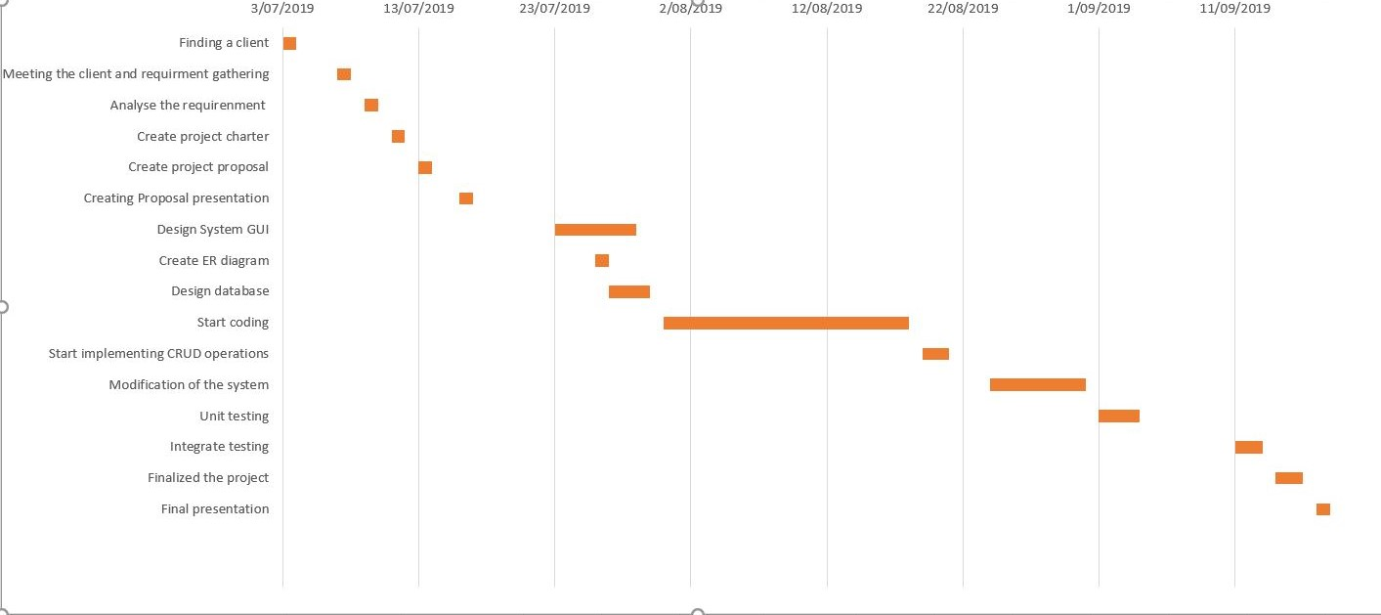
Gantt Chart

Slide 20


